Slide 1
Creating Engaging Avatar Videos

Slide 2

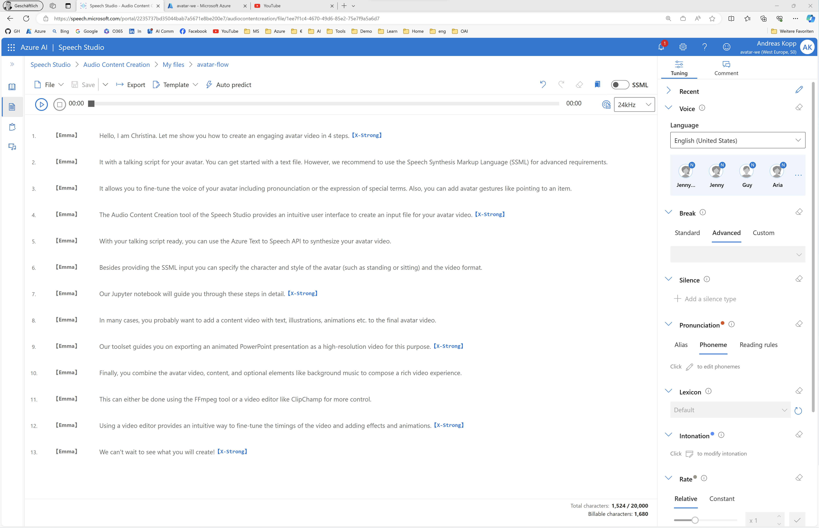
1. Create Avatar Talking Script

Slide 3

2. Generate TTS Avatar Video

Slide 4
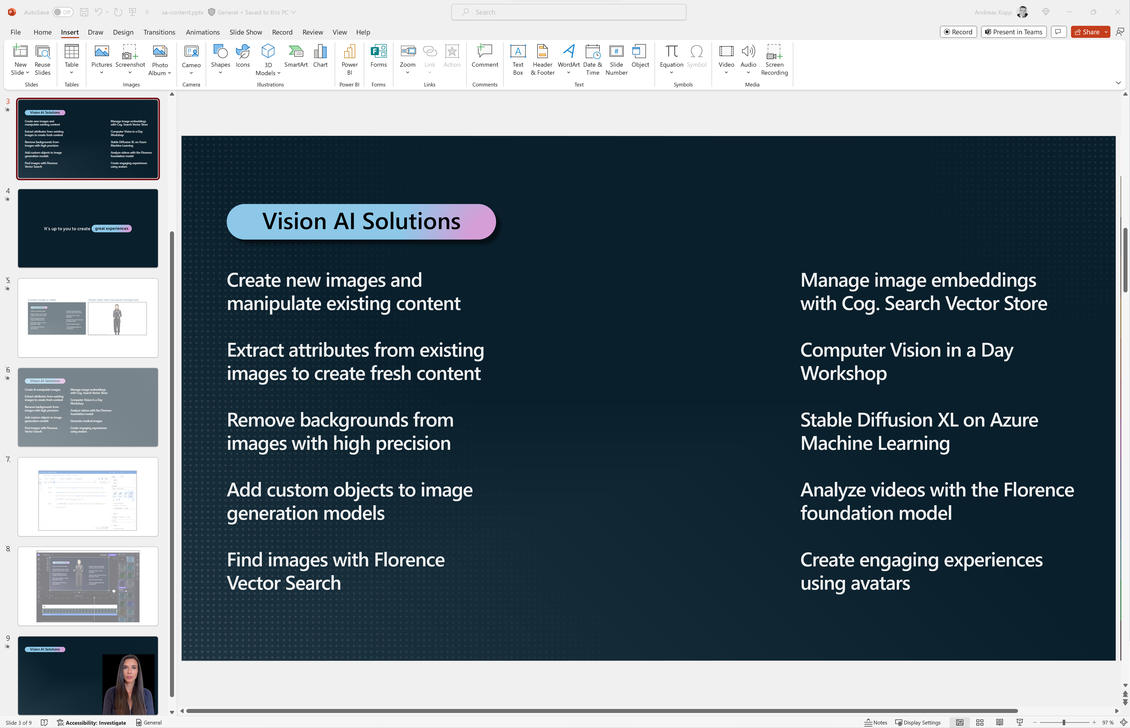
3. Create Content Video

Slide 5
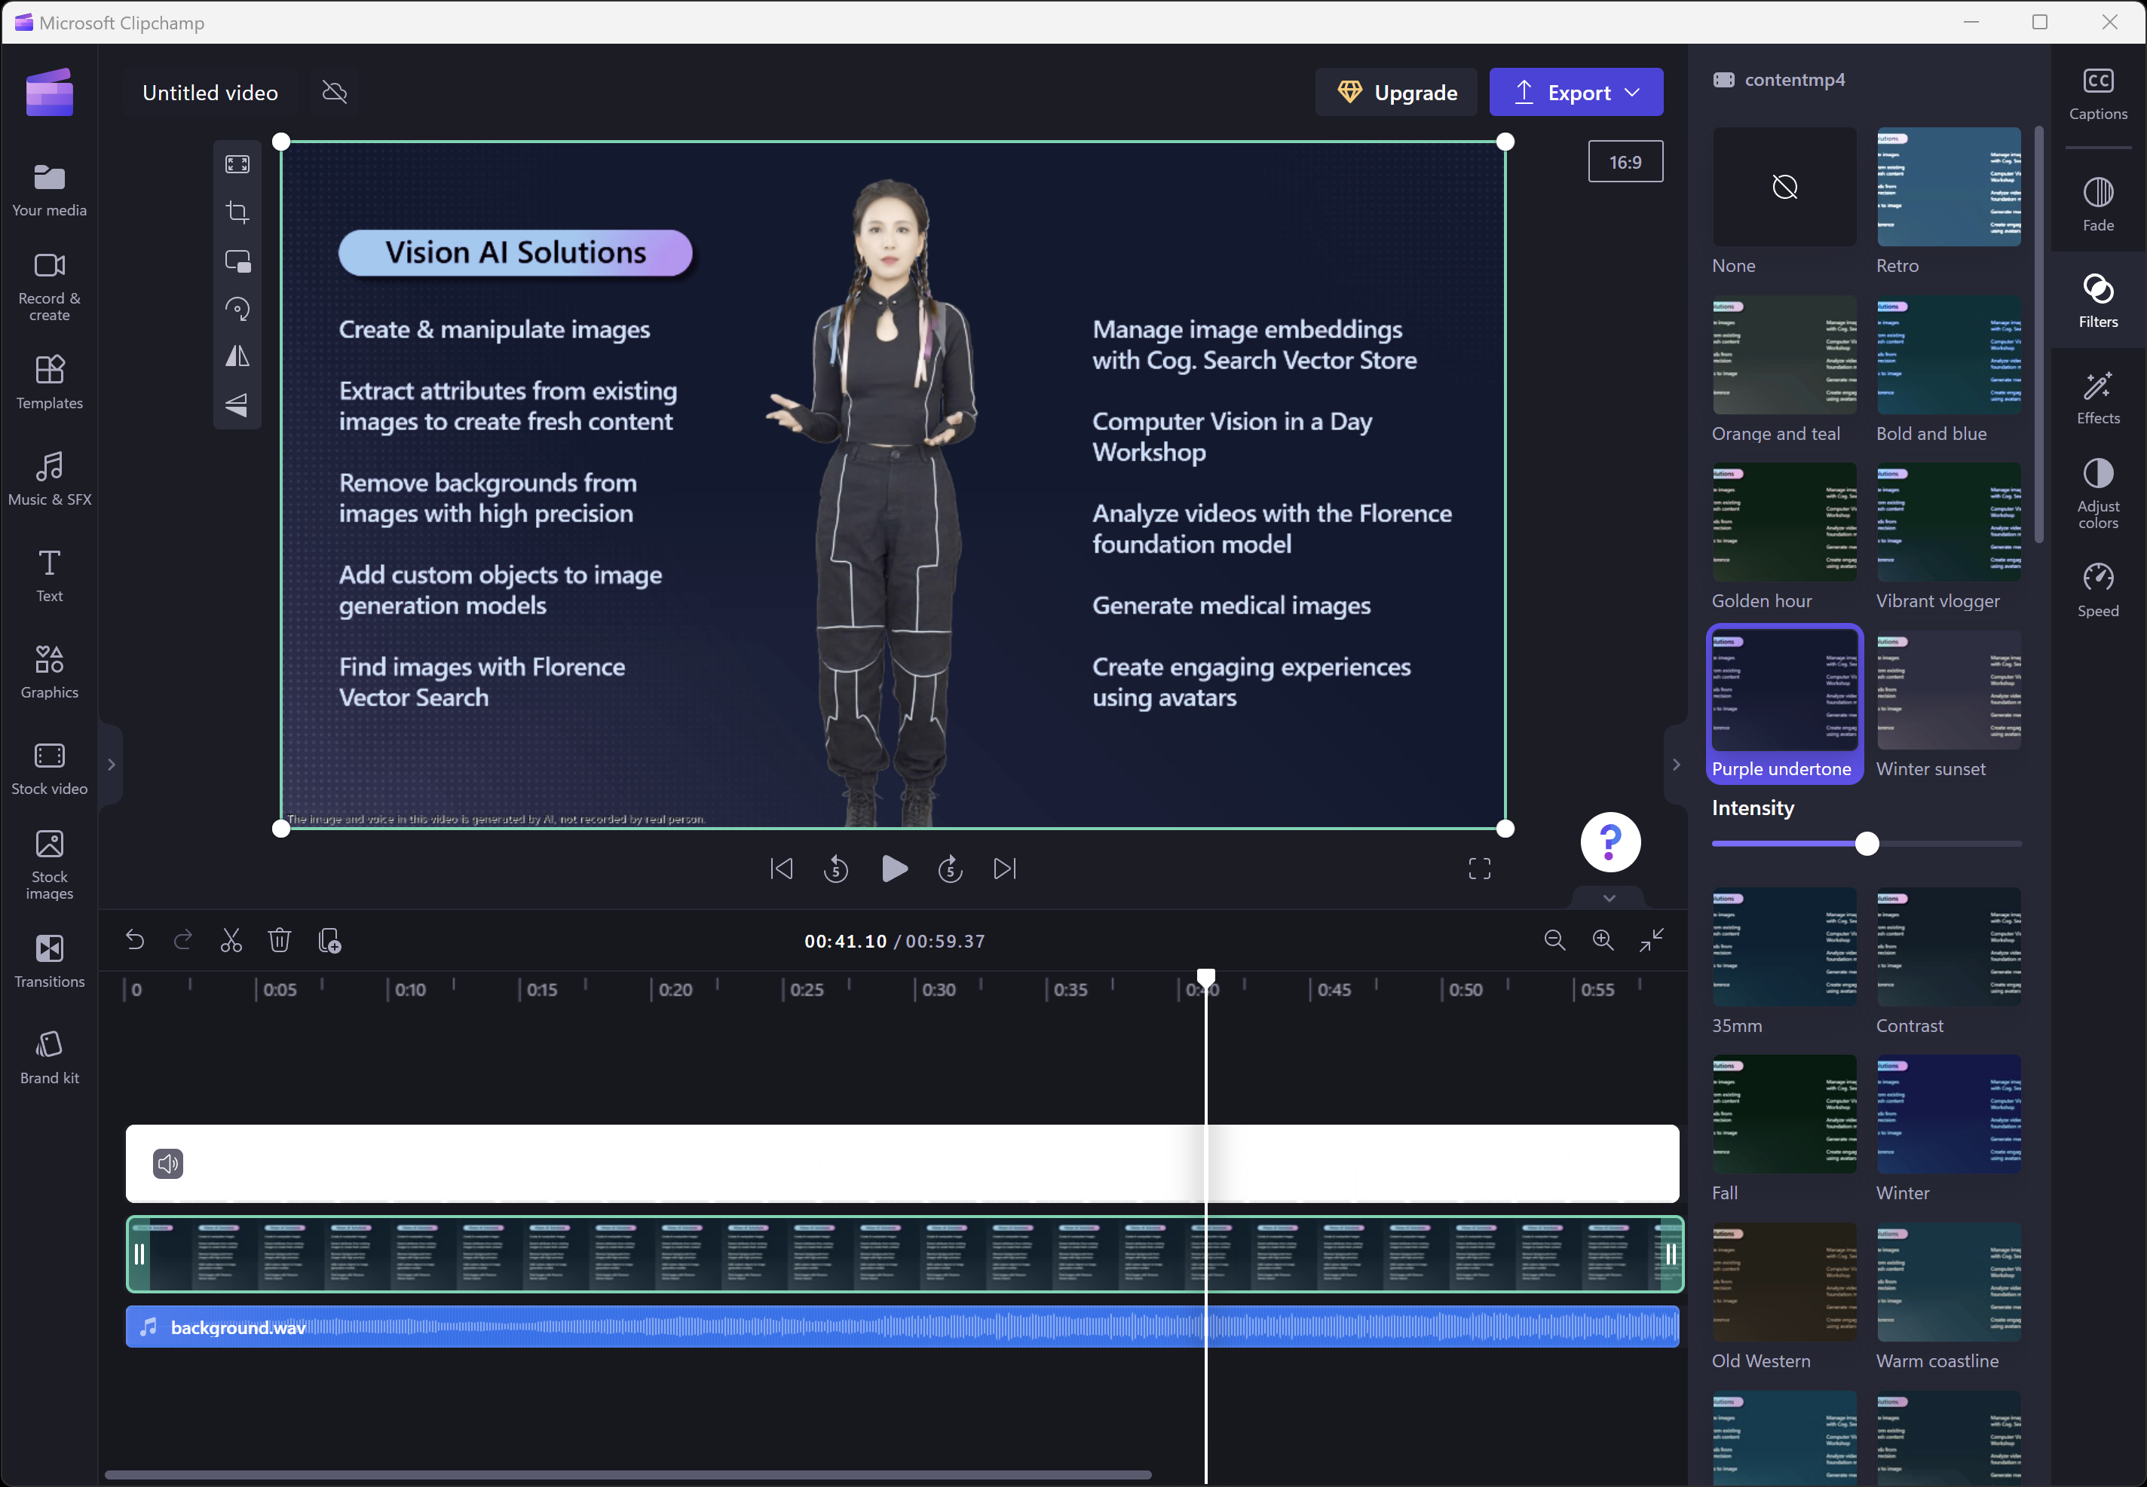
4. Compose Final Video

